Slide 1
Control Logic Design (Chapter 10)
Prof. Dr. Asaduzzaman
Dept. of CSE, CUET
asad@cuet.ac.bd

Slide 2
Introduction
The computer designed in chapter 9 can be run manually.
Automation is required in algorithmic procedure to achieve the objectives
Most challenging and creative part
The development of algorithm design requires
Understanding the problem
Initial configuration of equipments

Slide 3
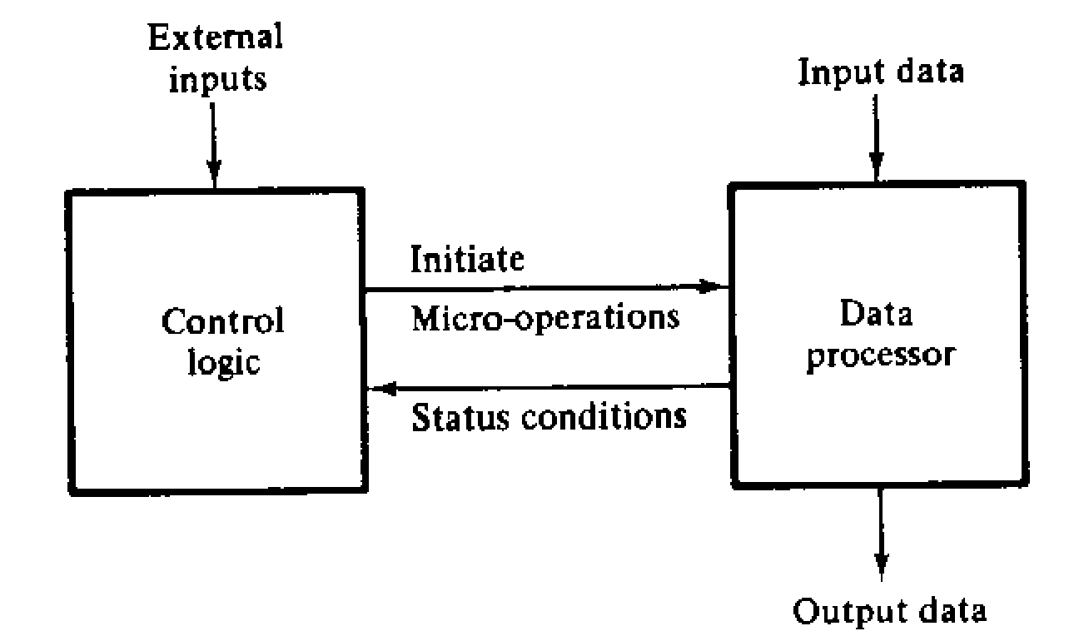
Introduction
Relationship between control and data-processor

Slide 4
Control Organization
Control is a sequential circuit
Can be designed by following the procedure in chapter 6.
Not practical because of
large number of states
Large number of gates and flip-flops
Specialize methods are needed to design control logic

Slide 5
Control Organization
Four methods of control
One flip-flop per state
Sequence register and decoder
PLA control
Microprogram control

Slide 6
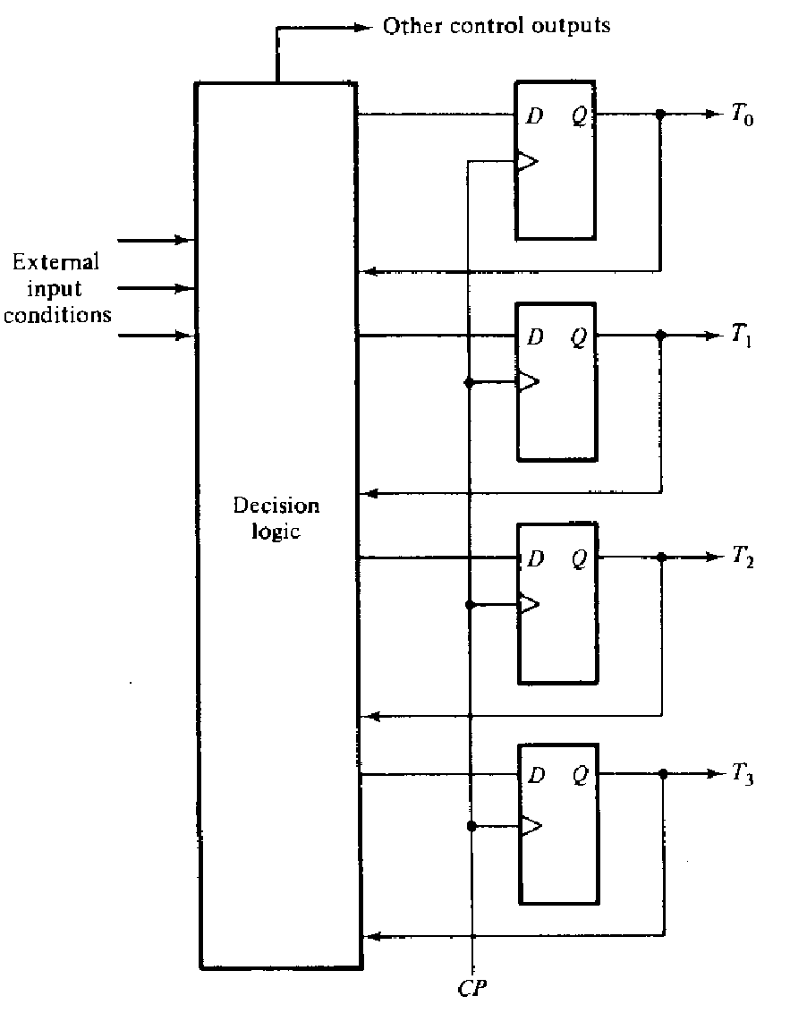
Control Organization
One flip-flop per state Method

Slide 7
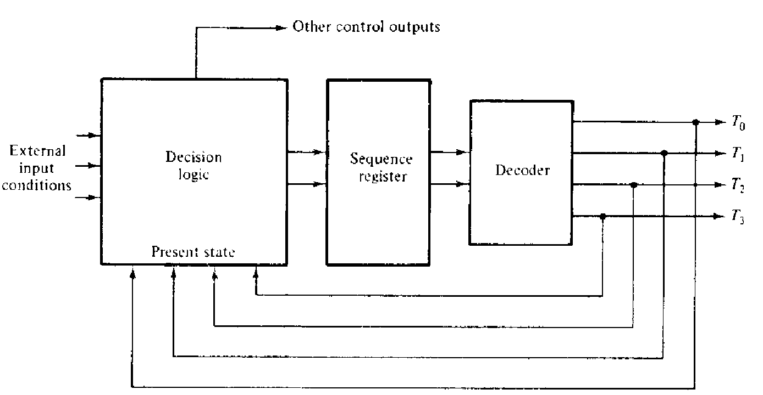
Control Organization
Sequence register and decoder method

Slide 8
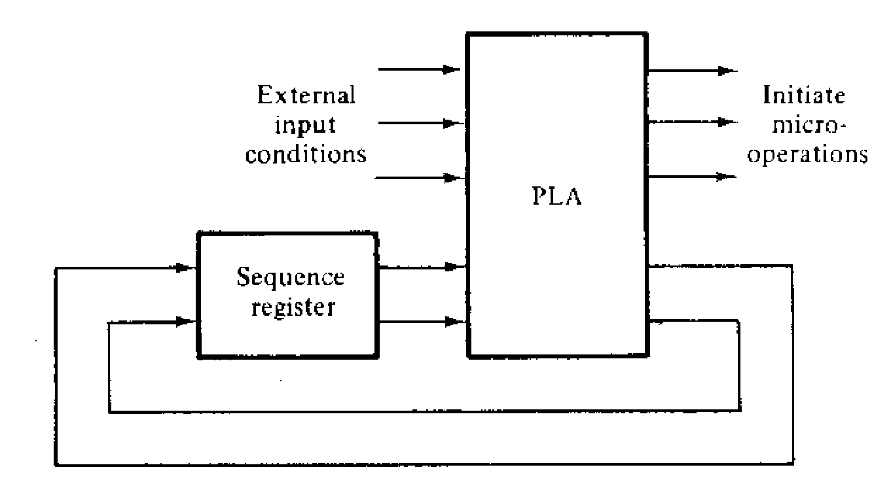
Control Organization
PLA control

Slide 9
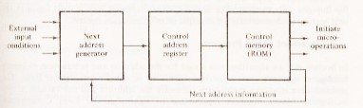
Control Organization
Microprogram control

Slide 10
Hardware Control
Design is carried out in consecutive five steps
The problem is stated
An initial equipment configuration is assumed
An algorithm is formulated
The data processor part is specified
The control logic is designed

Slide 11
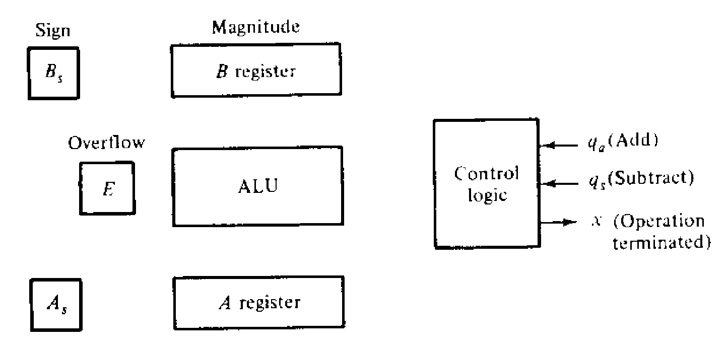
Hardware Control (Example 1)
Statement of the problem
Perform addition and subtraction of two fixed point binary number represented in sign magnitude form
Equipment Configuration

Slide 12
Hardware Control (Example 1)
Derivation of Algorithm
There are 8 combinations in (±A) ± (±B)
We can replace subtraction with addition as
(±A) - (+B) = (±A) + (-B)
(±A) - (-B) = (±A) + (+B)
Hence, reduced the possible conditions to 4
(±A) + (±B)

Slide 13
Hardware Control (Example 1)
The operations are summarized as
if A ≥ B if A < B
(+A) + (+B) = +(A+B)
(+A) + (-B) = +(A-B) = - (B-A)
(-A) + (+B) = -(A-B) = + (B-A)
(-A) + (-B) = - (A+B)

Slide 14
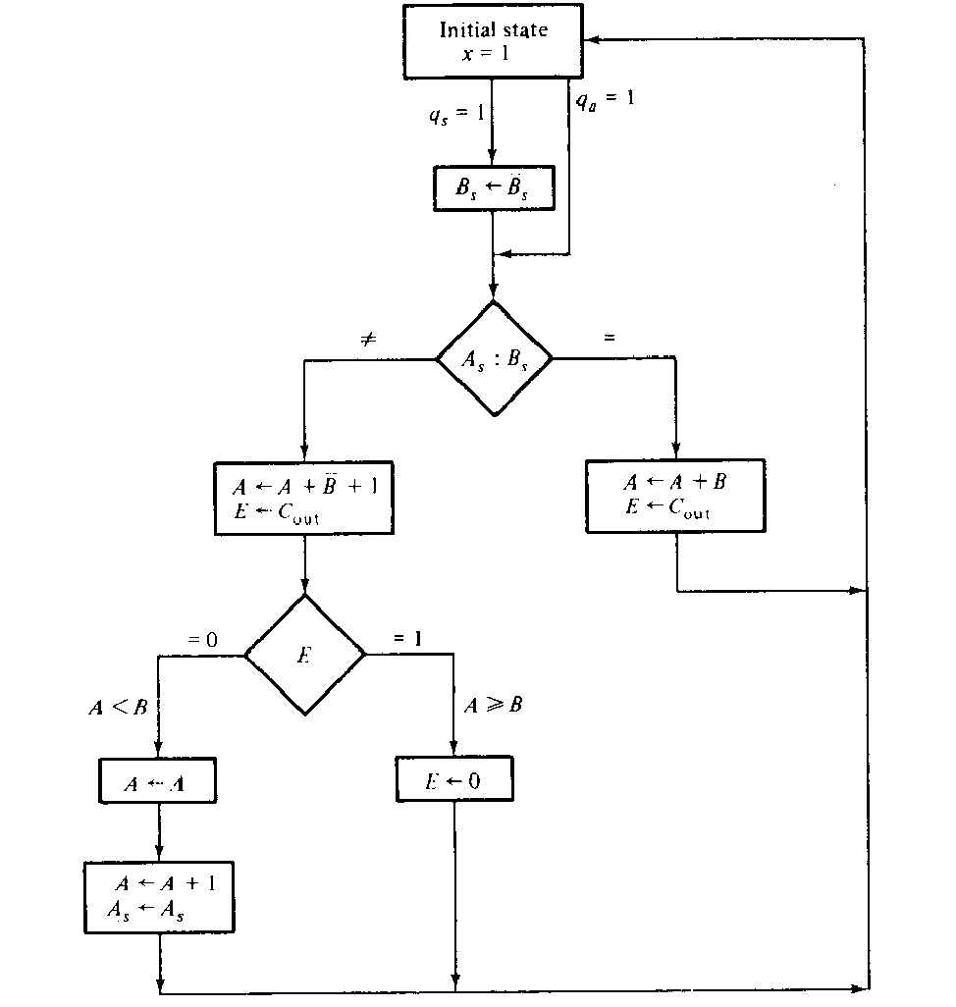
Hardware Control (Example 1)
Flow-chart

Slide 15
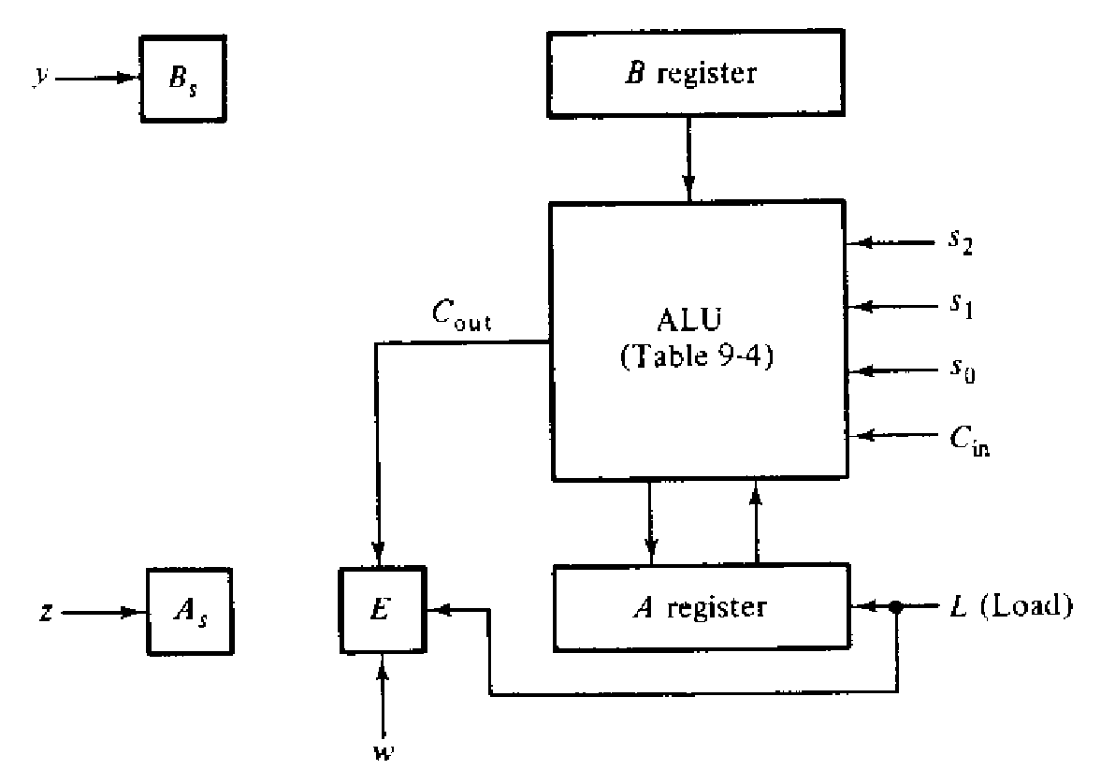
Hardware Control (Example 1)
Data processor Specification

Slide 16
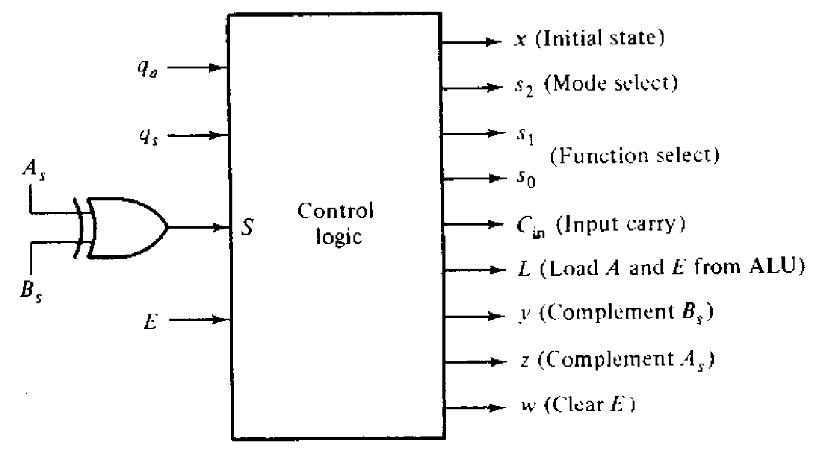
Hardware Control (Example 1)
Control Block Diagram

Slide 17
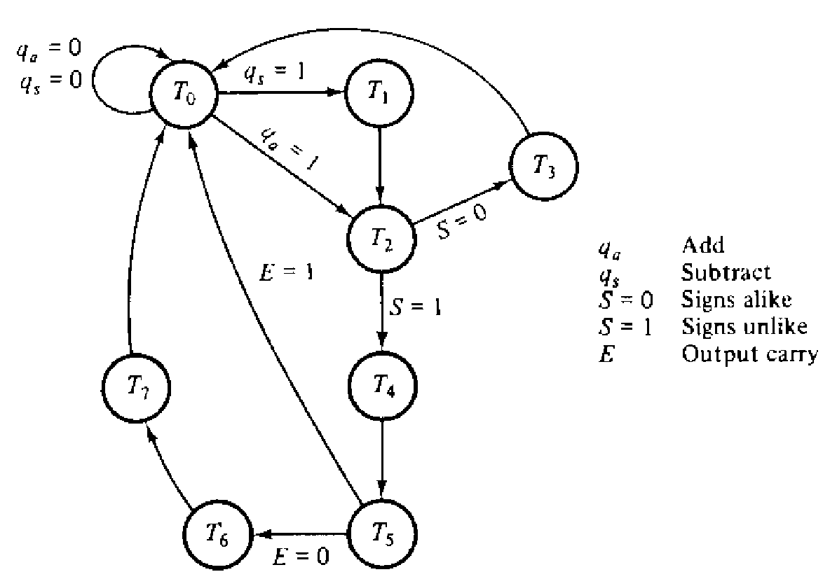
Hardware Control (Example 1)
Control State Diagram
C_{out} is transferred to E with a clock pulse that cause the control to go from T₄ to T₅.

Slide 18
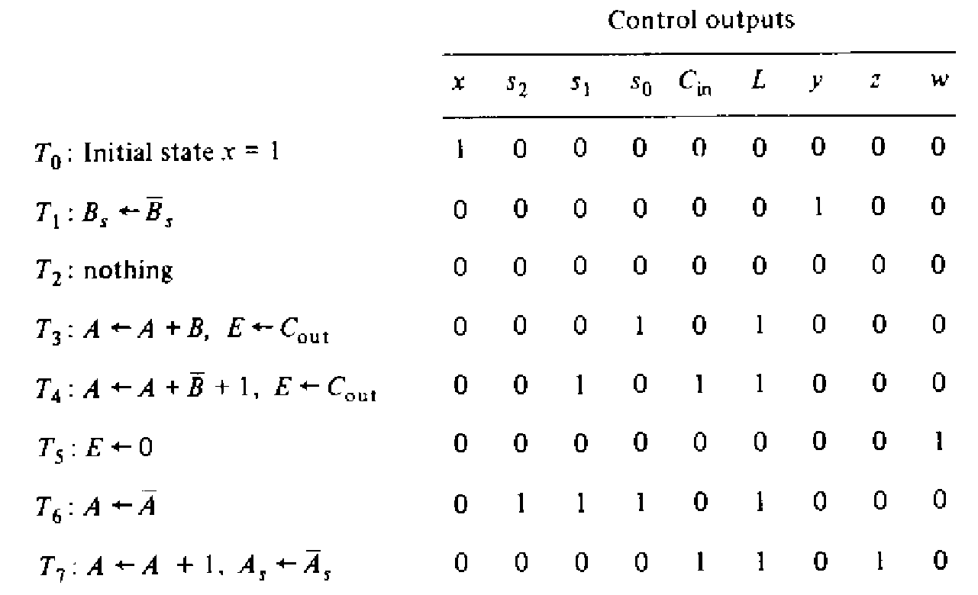
Hardware Control (Example 1)
Sequence of Register transfer

Slide 19
Hardware Control (Example 1)
Design of hard-wired control
It is easy to use D flip-flop because the next state of D flip-flop is function of D not the present state.
The condition for setting a flip-flop is specified in the state diagram.
For example-
Flip-flop T₂ is set if T₁=1 or T₀=1 and q_{a}=1; hence,
DT₂=q_{a}T₀+T₁

Slide 20
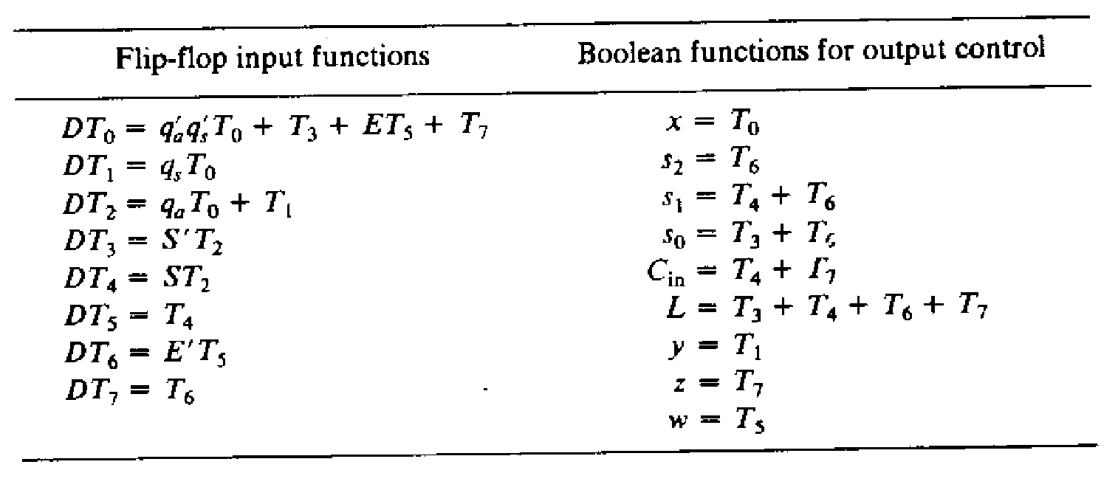
Hardware Control (Example 1)
Control Boolean Function

Slide 21
Microprogram Control
The control variables are stored in a memory
Usually in a ROM
The word stored is called microinstruction
Each microinstruction performs a micro-operation
After executing a micro-operation control must know the next address
A microinstruction contains bits for initiating microoperation and determining next address.

Slide 22
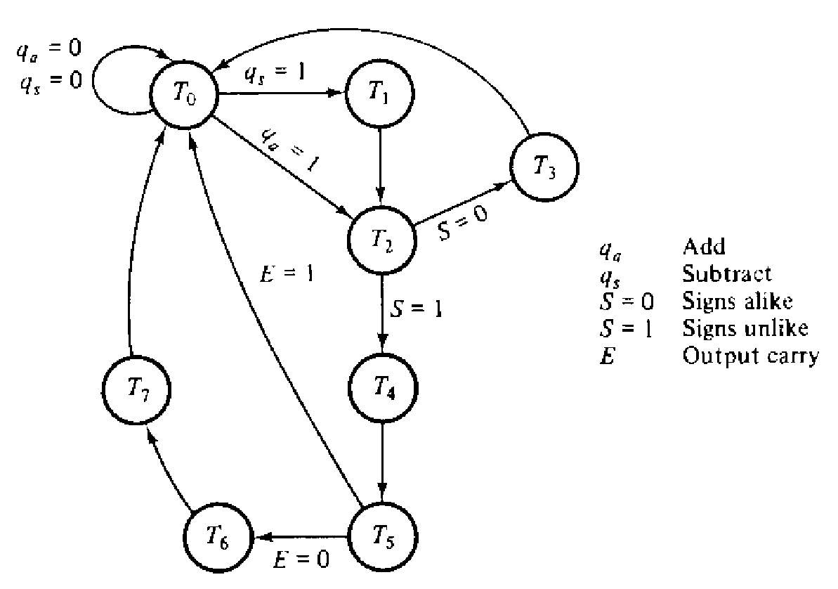
Microprogram Control
Consider the same problem

Slide 23
Microprogram Control
State diagram shows that the address sequencing must have the provision for -
loading an external address
Sequencing consecutive address
Choosing between two address

Slide 24
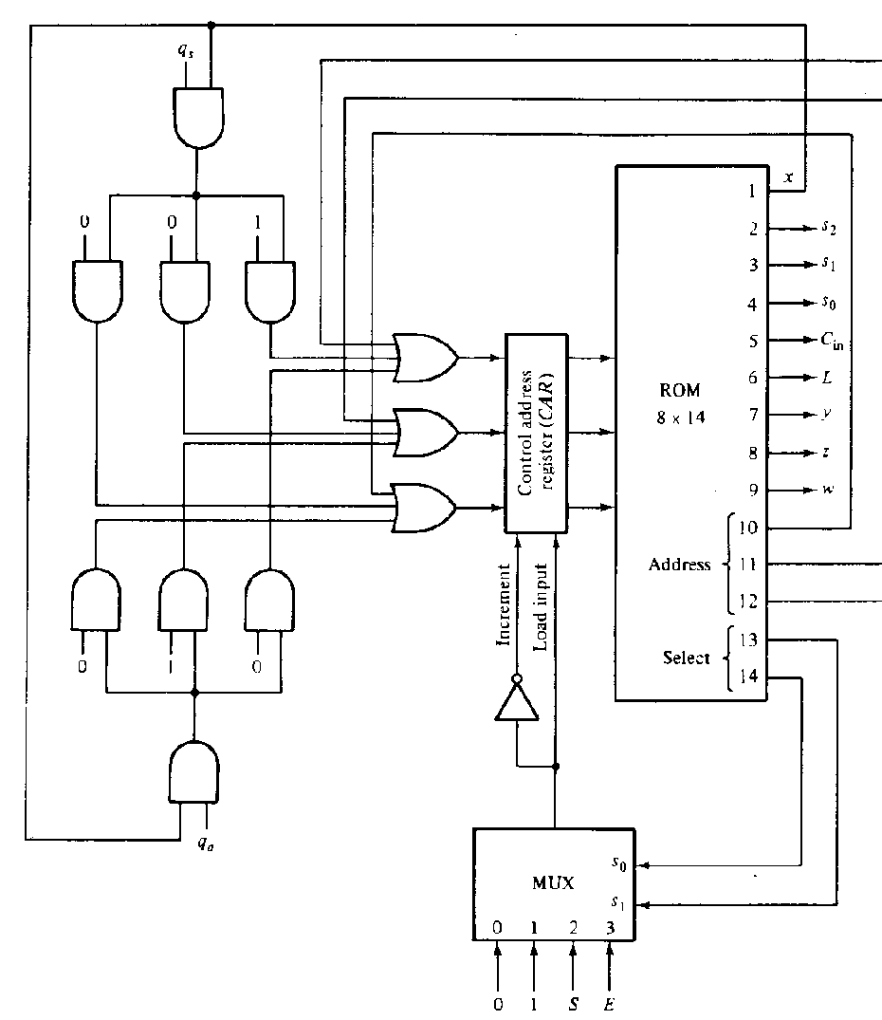
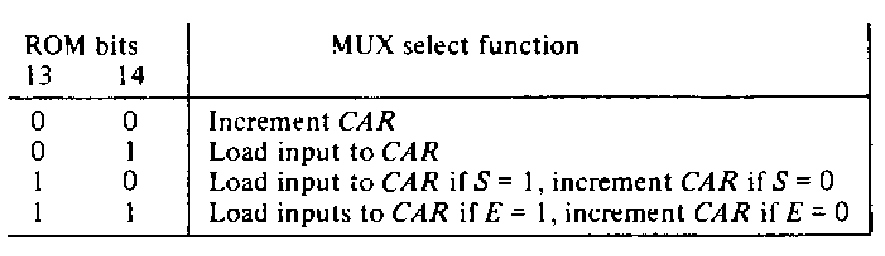
Microprogram Control
Hardware
8 word by 14 bit ROM

Slide 25
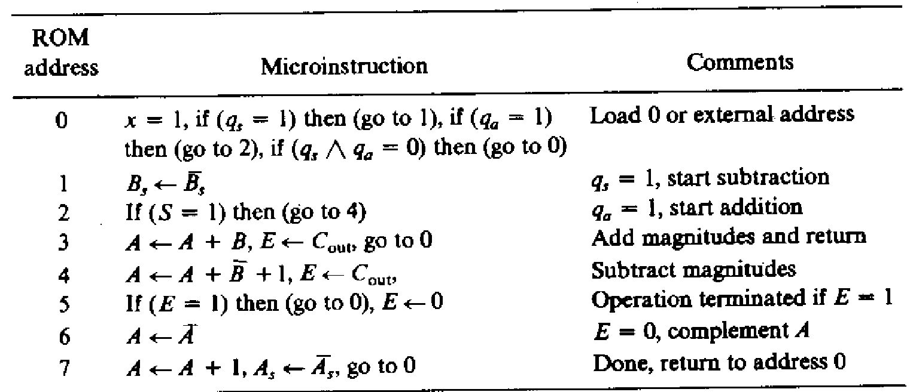
Microprogram Control
The Micro-program

Slide 26
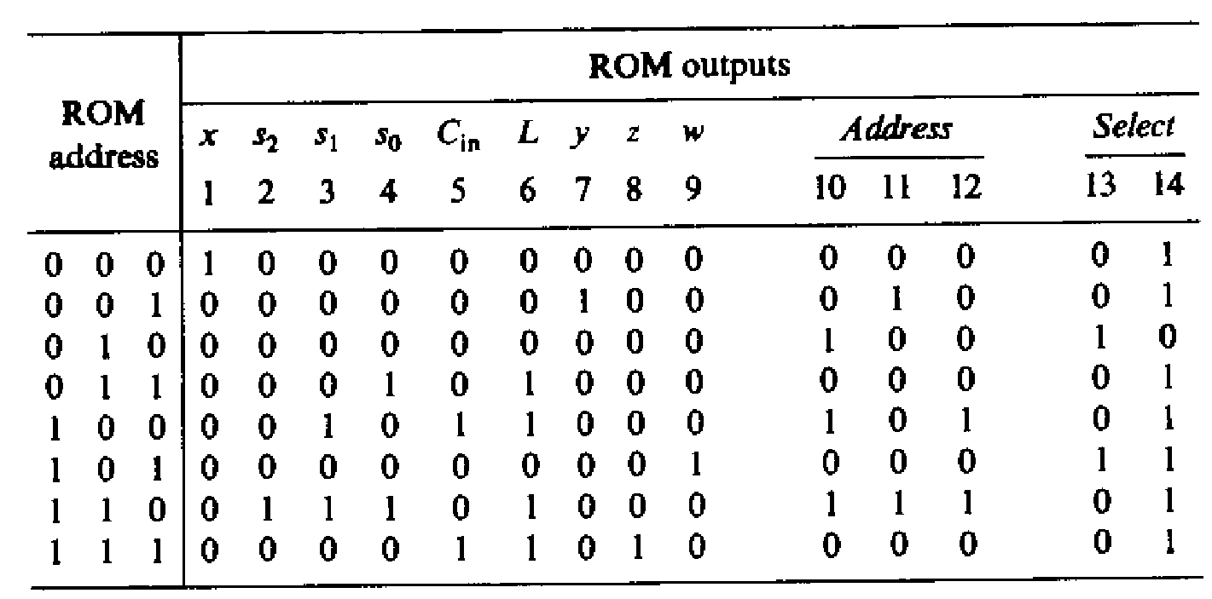
Microprogram Control
The Micro-program

Slide 27
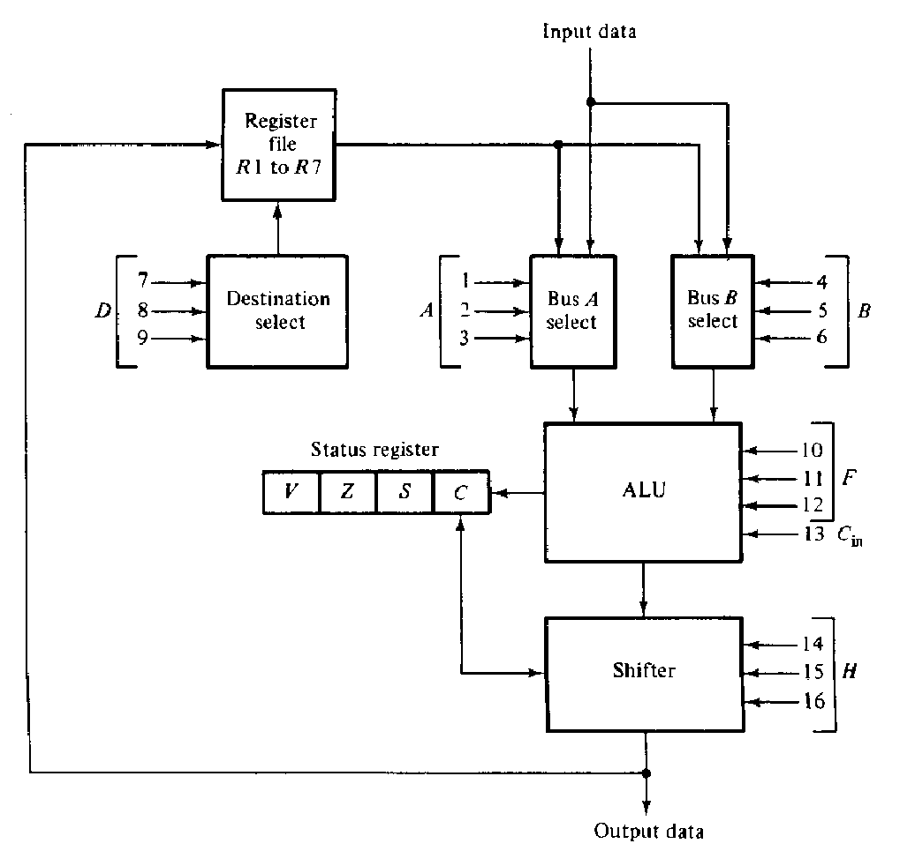
Control of the Processor Unit
The processor Unit (fig 9.16)

Slide 28
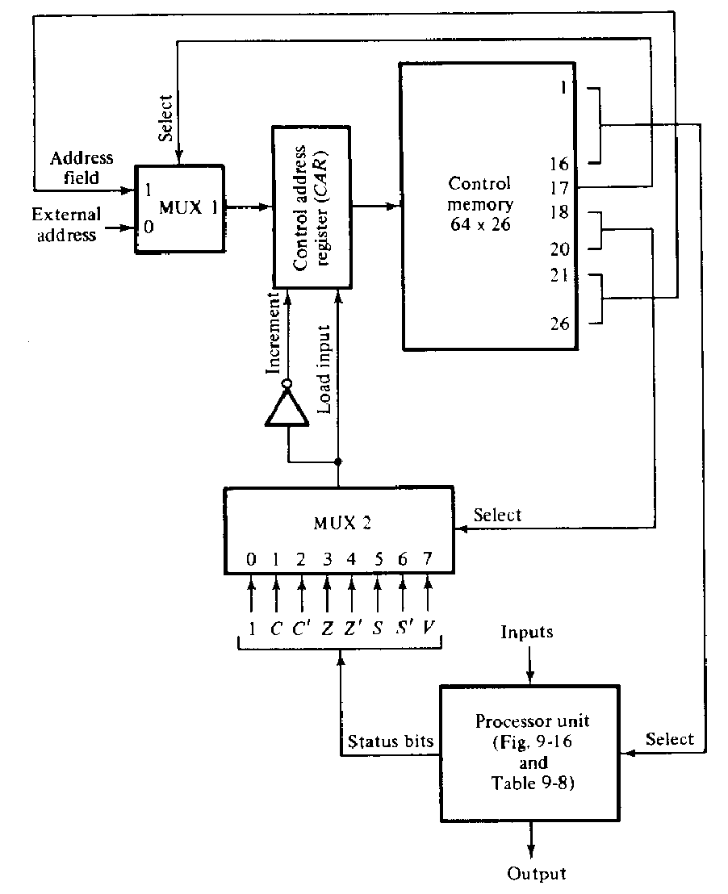
Control of the Processor Unit
Microprogram control of the processor unit

Slide 29
Control of the Processor Unit
Example
Count the number of 1’s presently stored in R₁ and set R₂ to that number
If R₁=00110101 the set R₂=100.
Construct a flow chart of this problem
Assume
Microprogram routine starts from address 8

Slide 30
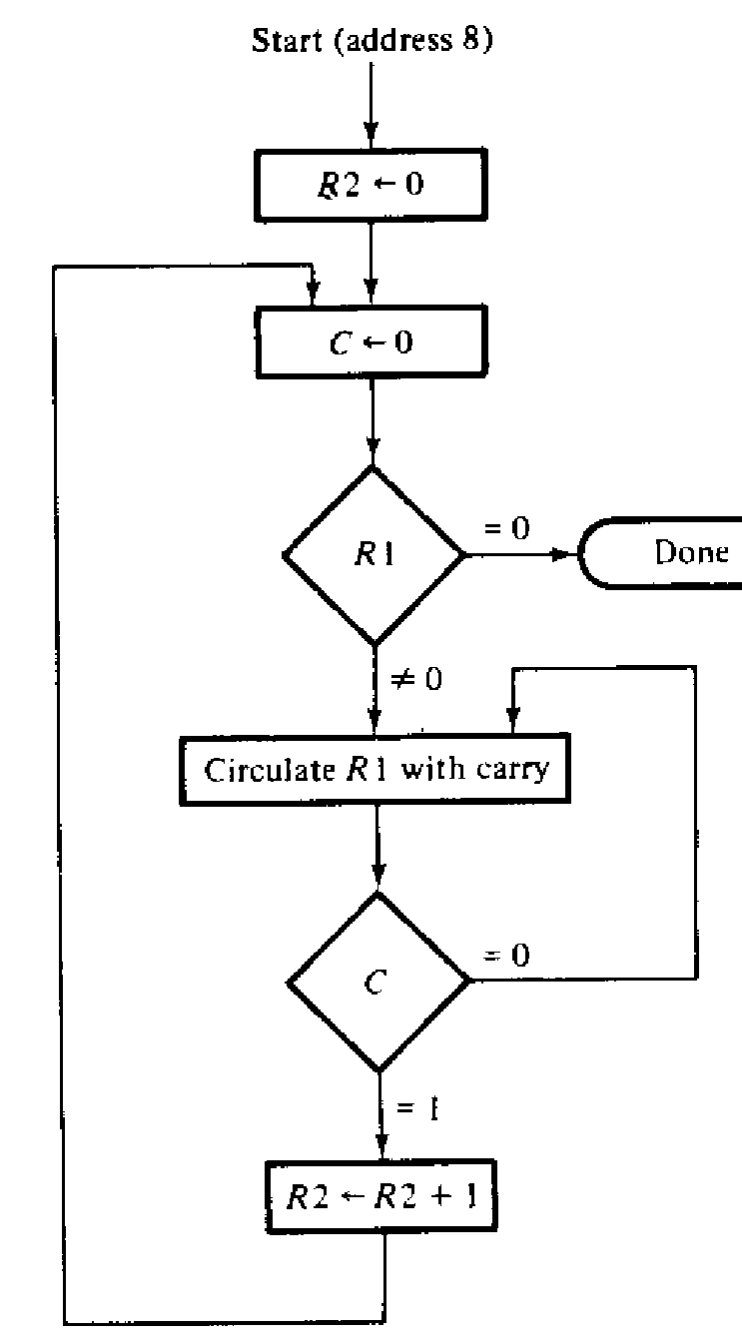
Control of the Processor Unit
Flow chart for counting 1’s in R1

Slide 31
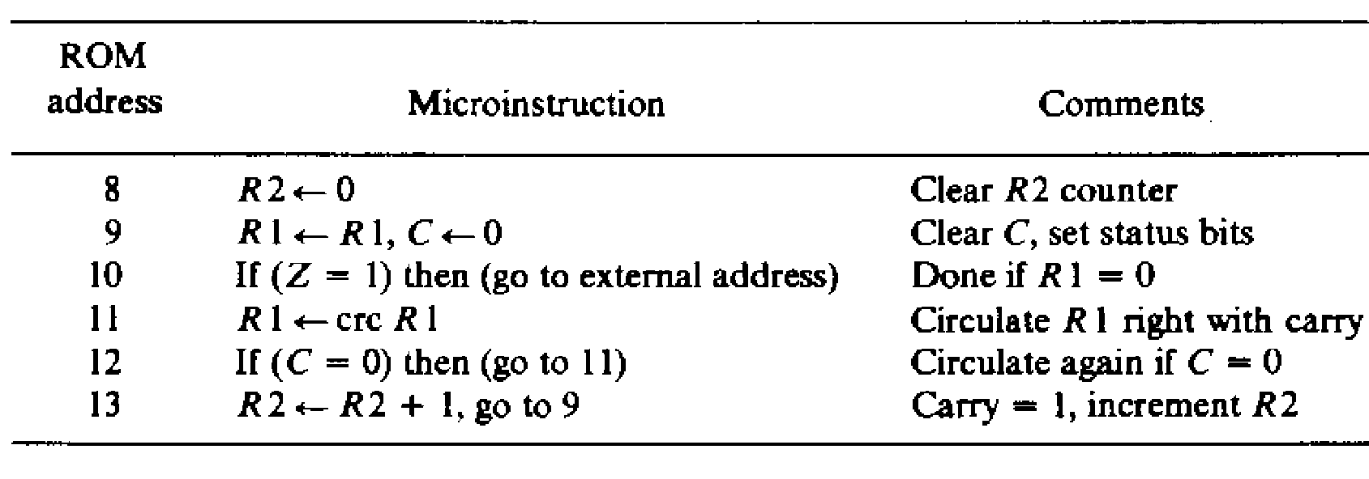
Control of the Processor Unit
Symbolic micro program

Slide 32
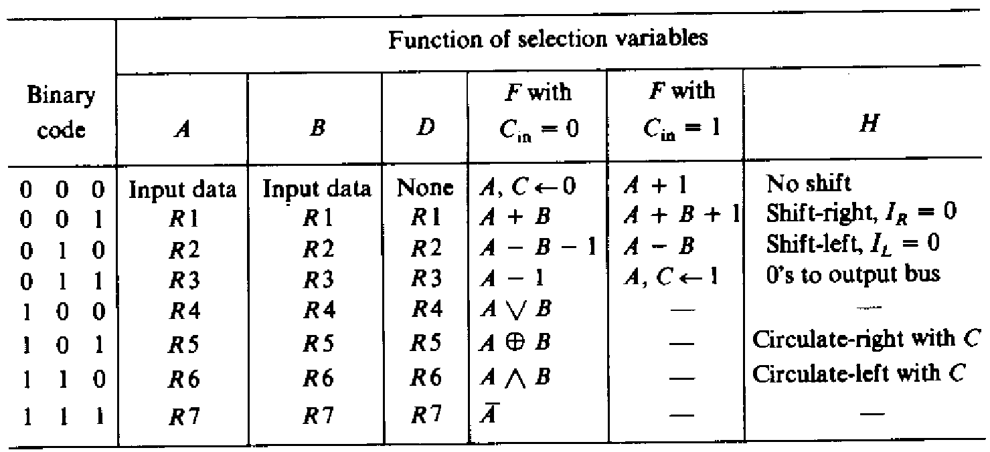
Processor Unit
Block Diagram with functions

Slide 33
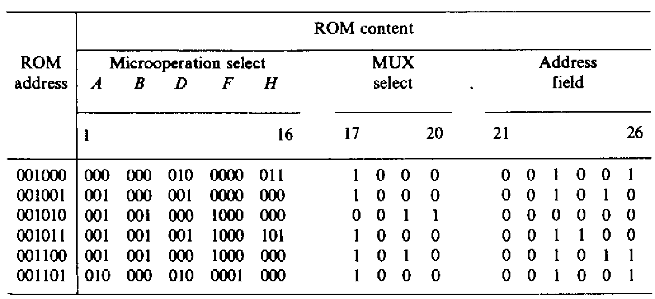
Control of the Processor Unit
Binary Microprogram

Slide 34
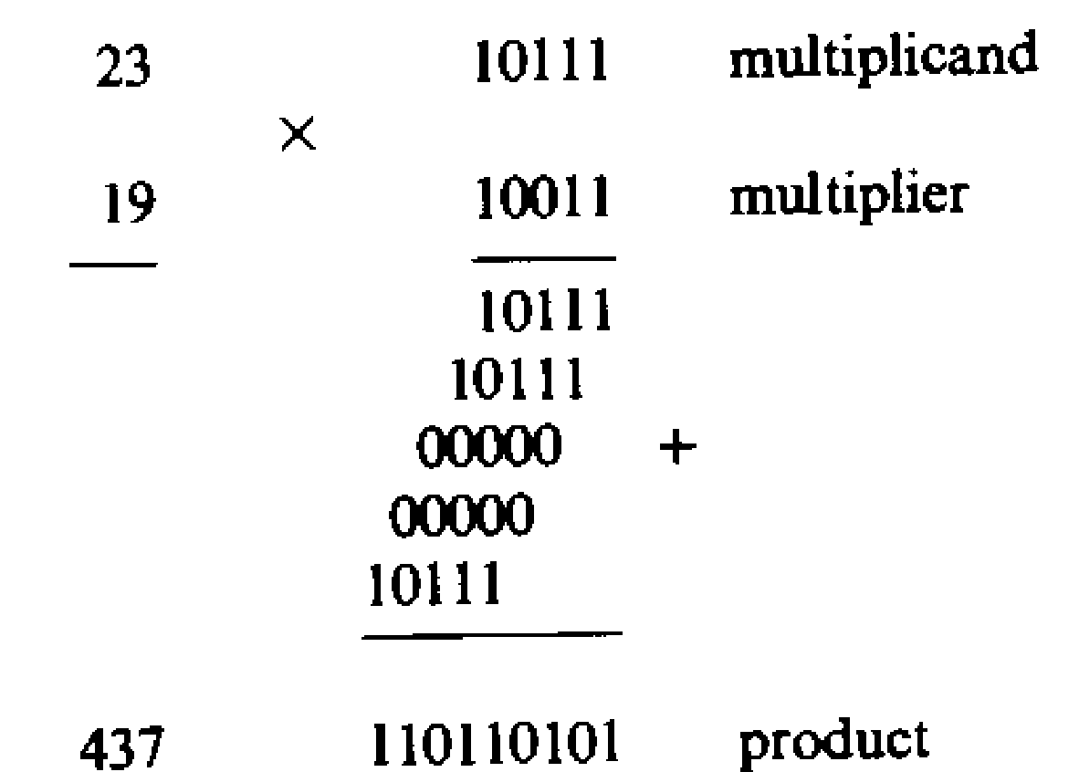
Hardware Control, Example2
Problem Statement
Design a digital system that multiplies two fixed-point binary numbers in sign magnitude presentation.
Example

Slide 35
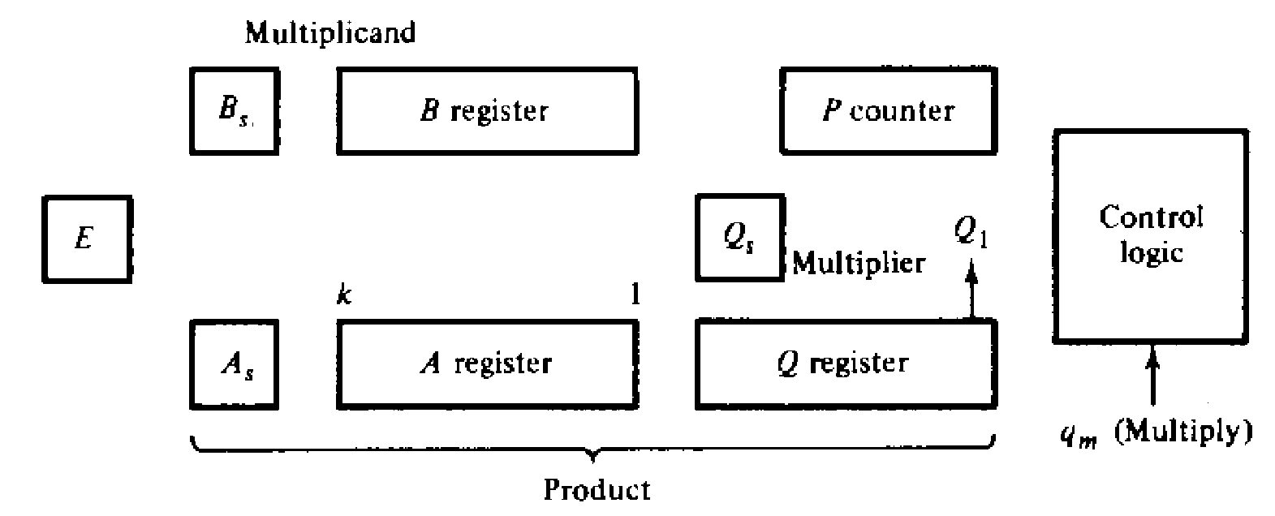
Hardware Control, Example2
Equipment configuration

Slide 36
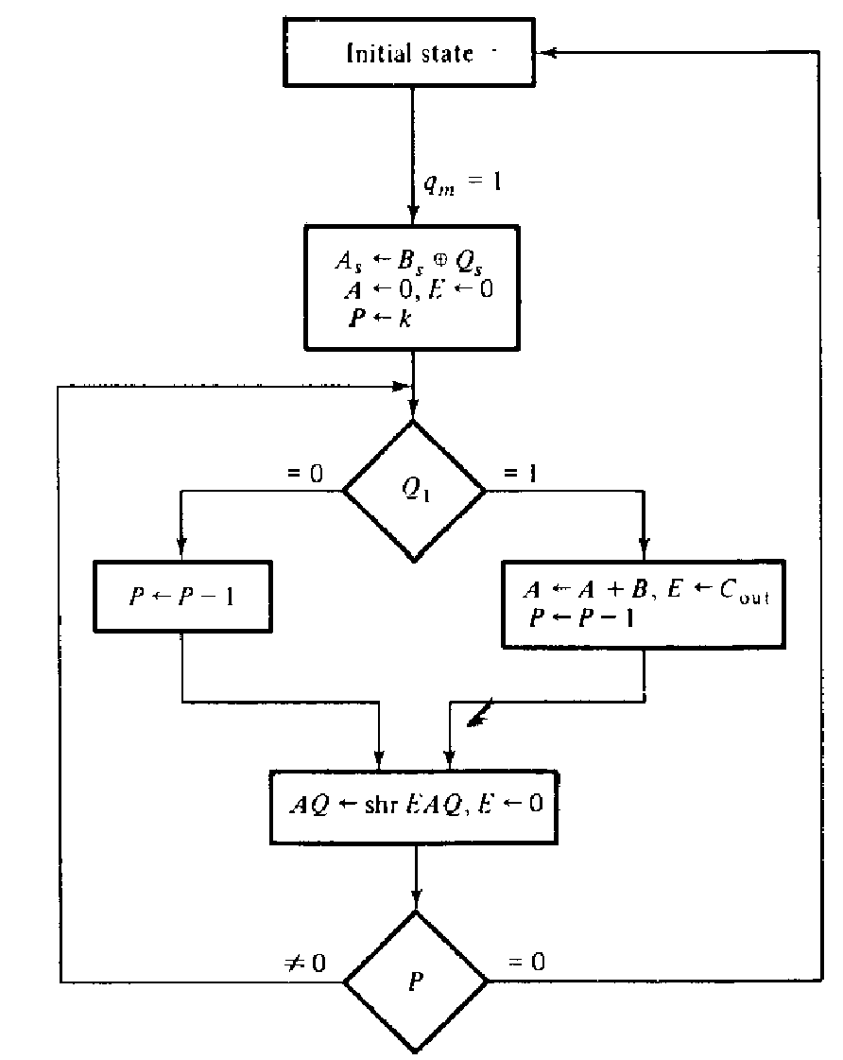
Hardware Control, Example2
Algorithm

Slide 37
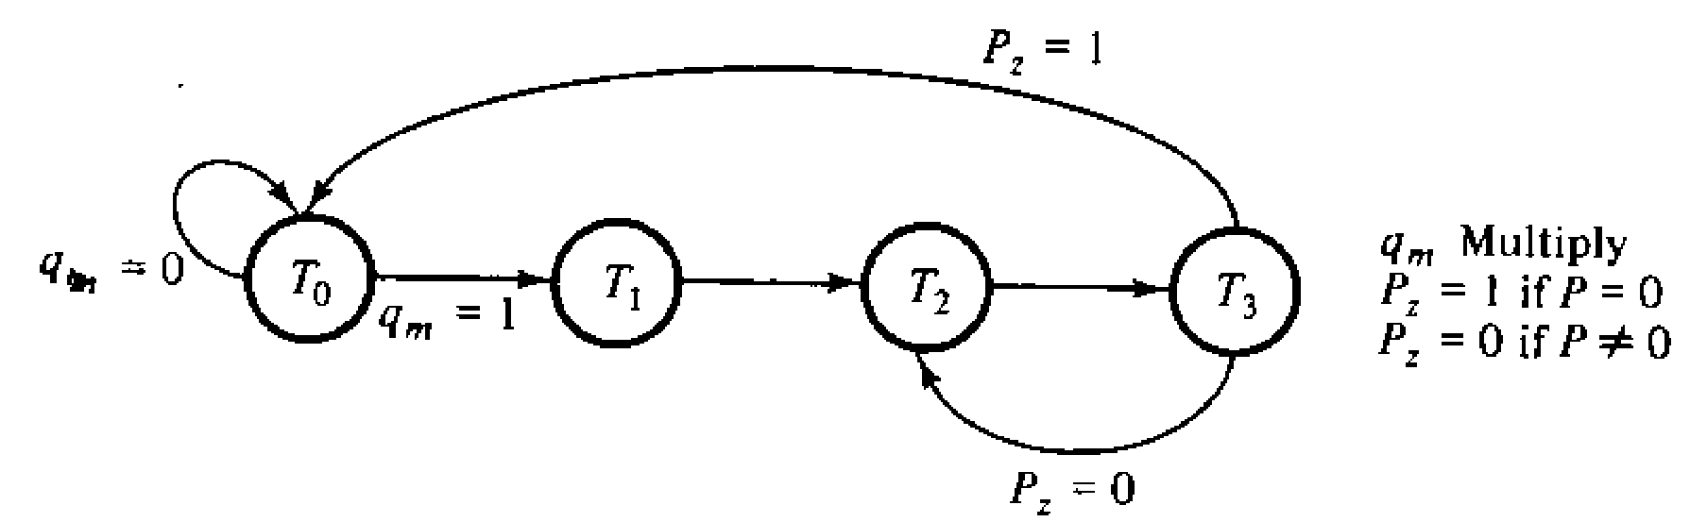
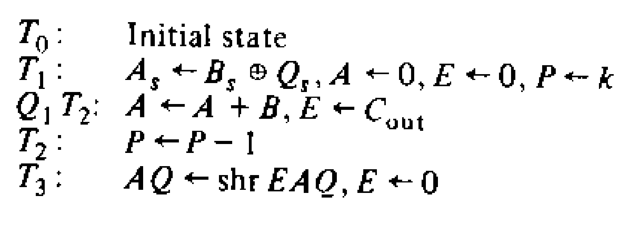
Hardware Control, Example2
State diagram

Slide 38
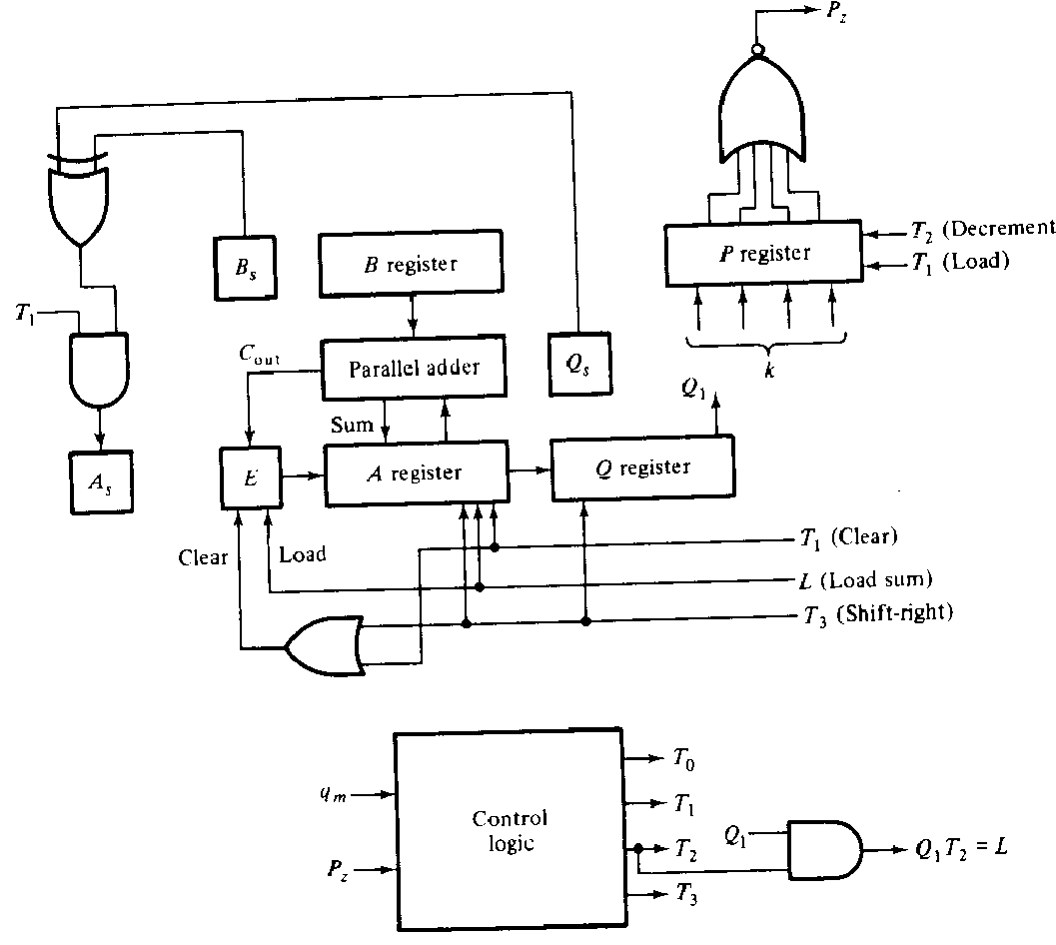
Hardware Control, Example2
Data processor Specification

Slide 39
Hardware Control, Example2
Design of Hardware Control
Use sequence register and decoder method
4 states and 2 inputs
Hence, required 2 flip-flops and a 2x4 decoder.
Two JK flip-flops are labeled G1 and G2.

Slide 40
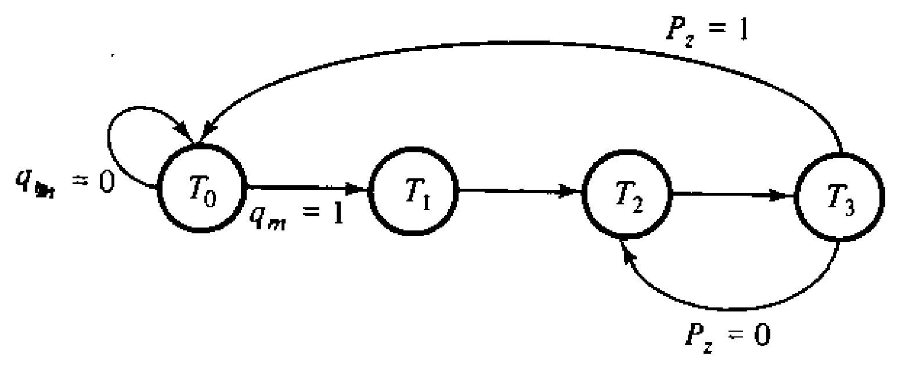
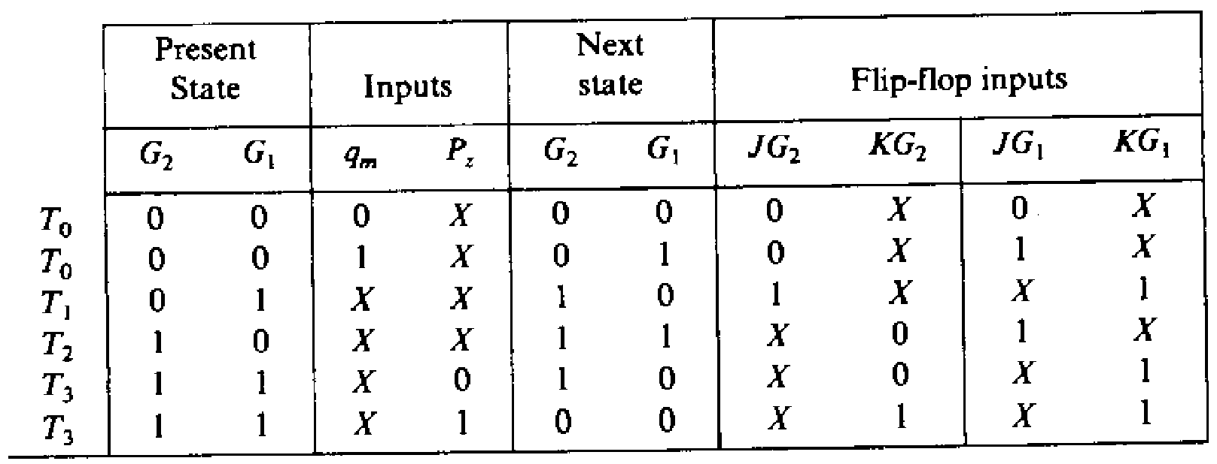
Hardware Control, Example2
Flip-flop Excitation
JG₁=T₀q_{m}+T₂ JG₂=T₁
KG₁=1 KG₂=T₃P_{z}

Slide 41
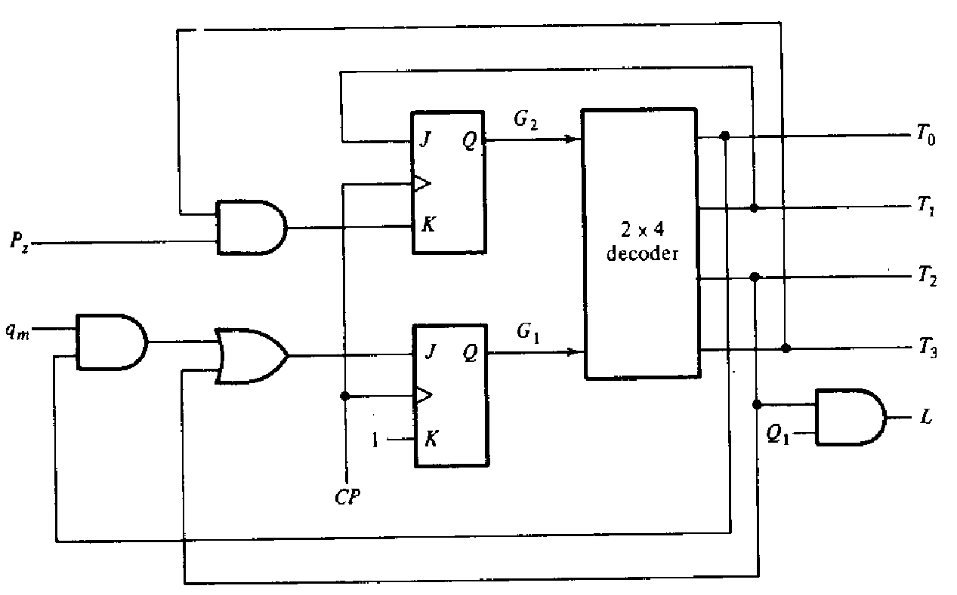
Hardware Control, Example2
Control Logic Diagram

Slide 42
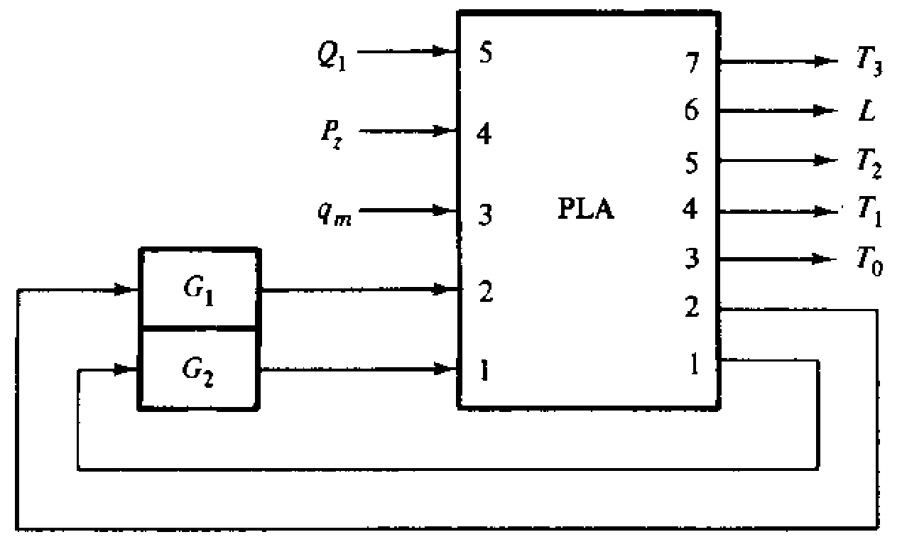
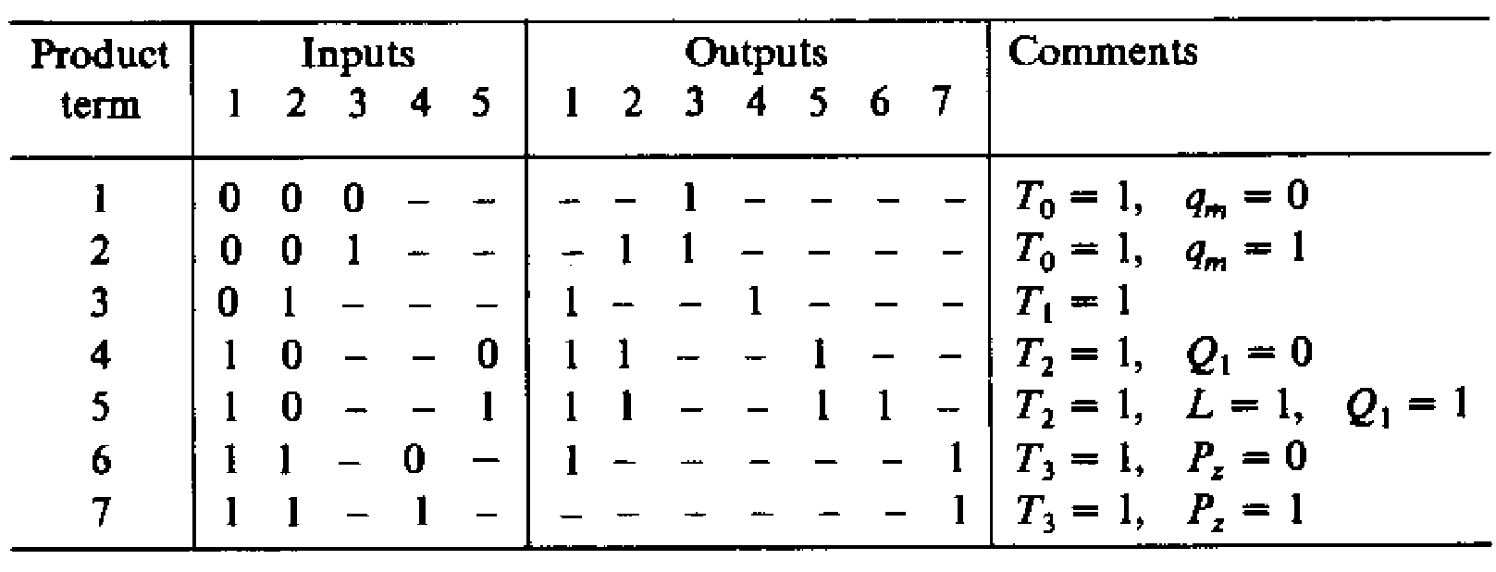
PLA Control
PLA control for binary multiplayer

Slide 43
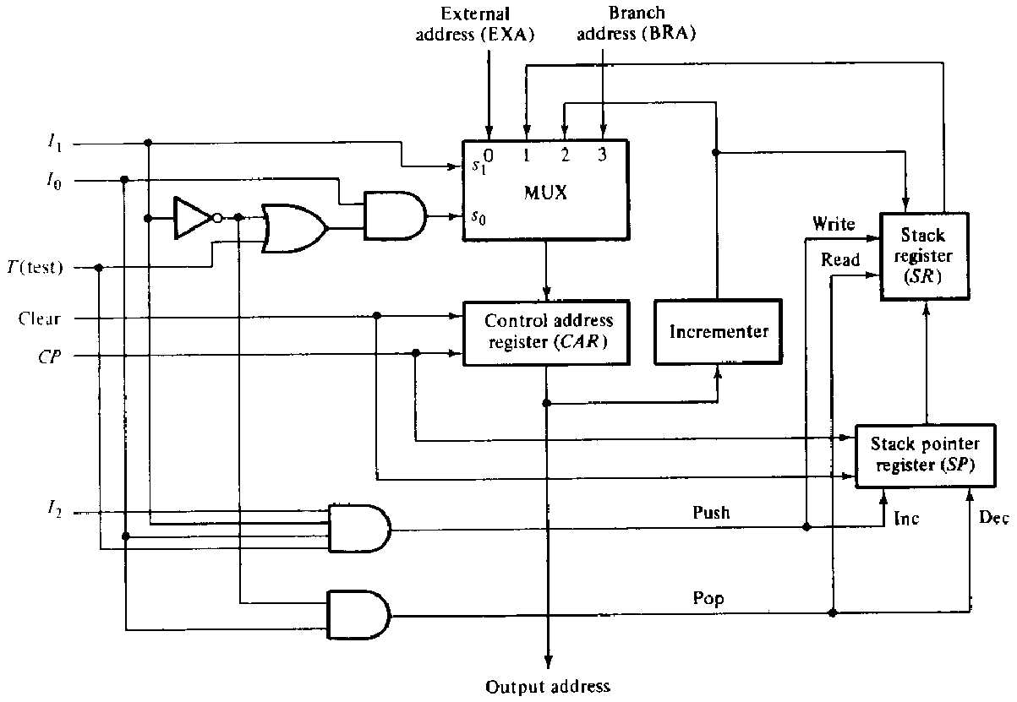
Microprogram sequencer
A typical Microprogram sequencer organization

Slide 44
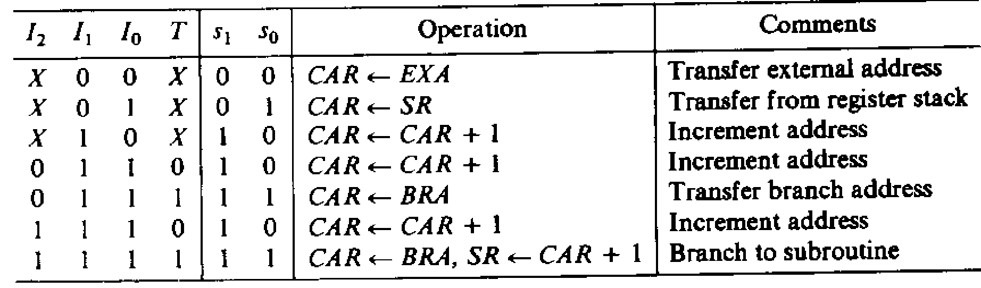
Microprogram sequencer
Functional Table of the sequencer

